Slide 1
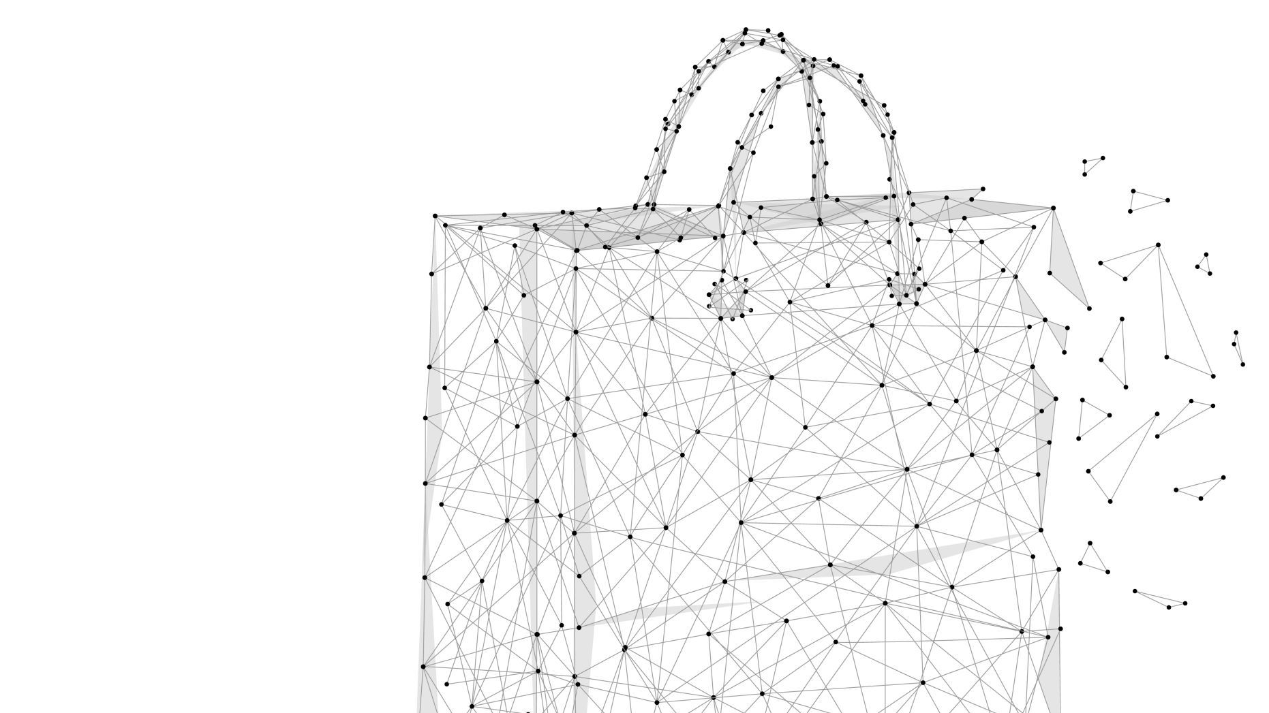
BLACK FRIDAY
Intelligent System
Alex Fichtner
Mehek Kumar
Kyle Wolff

Slide 2
Introduction
Black Friday began in the 1950s, originally coined by Philadelphia police to describe the post-Thanksgiving shopping chaos.
Retailers later rebranded it to highlight profitability—moving from “red” to “black” in accounting terms.
Cyber Monday was introduced in 2005 by Shop.org, sparked by the surge in online shopping the Monday after Thanksgiving.
Both have grown into global shopping phenomena with billions in sales, driven by mobile commerce and e-commerce platforms.

Slide 3
Objective
Build a Black Friday Intelligence System that collects and analyzes structured and semi-structured data.
Extract meaningful insights such as:
Historical discount trends
Sentiment of news coverage
Deal quality assessments
Understand how consumer behavior and promotional strategies have evolved over time.

Slide 4

Data Sources
Structured Data
Amazon product data via Keepa API
Pricing history, deal frequency, discount depth
Used for trend analysis and regression modeling
Semi-Structured Data
News articles from major media outlets (CNN, NPR, CNBC)
Tweet sentiment from historical data

Slide 5
System Overview
Data Collection
Data Storage
Data Analysis
Visualization
Modeling
Components

Slide 6
Sentiment Analysis
Non-Python (Tweet-Based) Analysis (2006–2020)
📉 Negative sentiment has increased over time:
Complaints about limited stock, commercialization, and chaotic crowds
📈 Positive themes:
Convenience of online shopping
Excitement around major deals
📊 Recent Shifts:
Inflation & economic uncertainty = cautious spending
Shoppers prioritize necessities over splurges
Surge in Cyber Week preference over traditional in-store rush

Slide 7
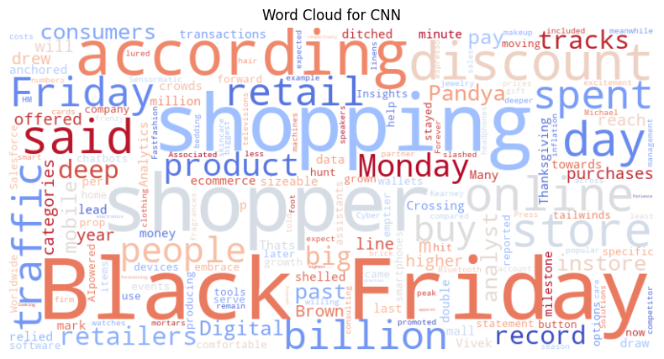
Sentiment Analysis
Python-Based Sentiment Analysis (2023–2024)
Sources: CNBC, CNN, NPR
All articles ranged from neutral to positive
Focus on economic impact & online sales growth
Online sales reached $9.8B in 2023, a 7.5% increase YoY
Consumers more strategic and calculated
Mixed views on pricing tactics
Rise in price comparisons and extended deals
Cyber Week > Black Friday in engagement; foot traffic only up 1%

Slide 8
Regression Model
Objective: Understand how item type and Black Friday/Cyber Monday timing affect product pricing.
Variables:
Independent: Item, Days since Oct 1, Black Friday/Cyber Monday flag
Dependent: Price
Findings:
Electronics like gaming PCs and consoles are priced significantly higher
Prices are ~$8 lower during Black Friday/Cyber Monday
Model Performance: R² = 0.9939, indicating very strong explanatory power

Slide 9
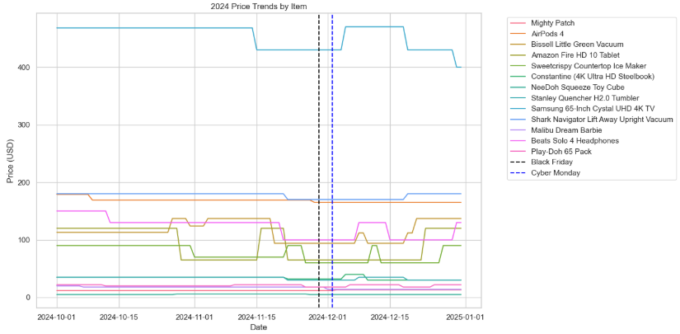
Price Trends

Slide 10
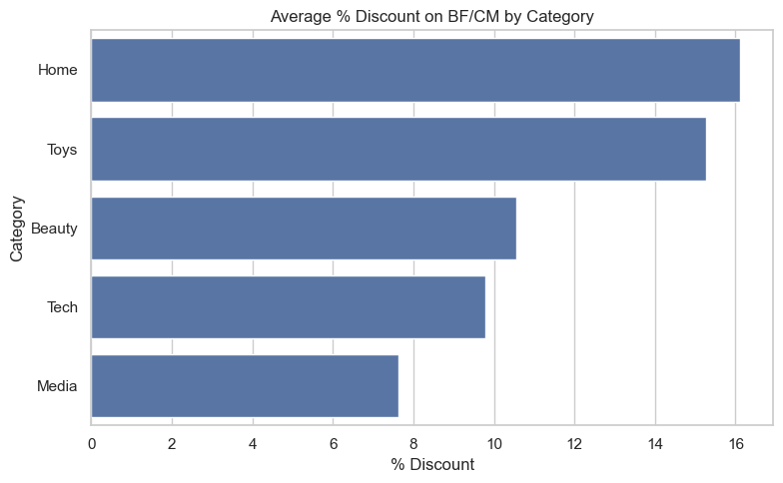
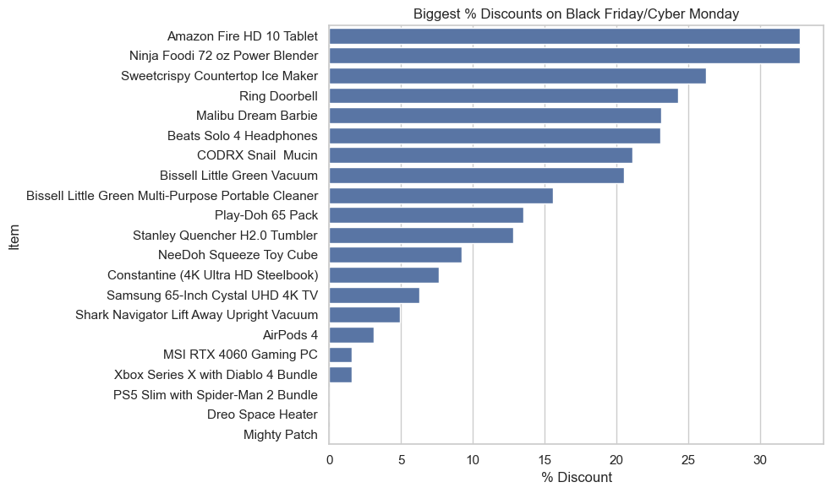
Visual Insights

Slide 11

Key Findings & Takeaways
Findings:
Some deals are genuine, especially on electronics.
Instances of inflated Prices to showcase higher discounts.
Conclusion: Not all deals offer real savings; consumers should be cautious.
Black Friday and Cyber Monday remain significant retail events.
Consumer behavior is shifting towards online shopping and strategic purchasing.
Data analysis reveals insights into trends, sentiments, and deal authenticity.
The developed system provides a foundation for informed decision-making by consumers and retailers.

